Slide 1
Are we set up for financial success?
Lucien H. Fuertes

Slide 2
Agenda
My Background
Project Introduction
Methods Used
Results
Summary
Conclusions
Questions

Slide 3
Agenda
My Background
Project Introduction
Methods Used
Results
Summary
Conclusions
Questions

Slide 4
Lucien H. Fuertes
Previous Education: Computer Science Bachelor’s Degree
Previous Employment: US Air Force (Active Duty & Civilian)
Current Employment: Software Developer (SQL) – CyraCom International Language Solutions
Other Interests: Personal Finance Coach, Competitive Cyclist, Church Small Groups

Slide 5
Agenda
My Background
Project Introduction
Methods Used
Results
Summary
Conclusions
Questions

Slide 6

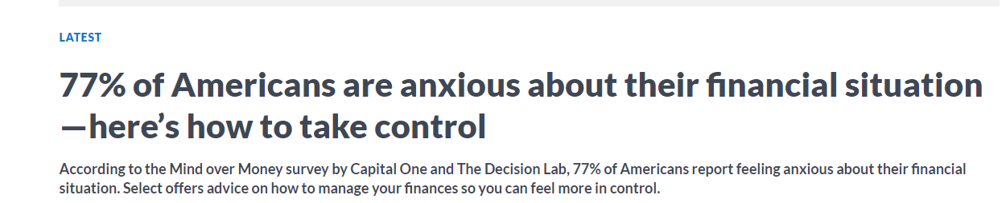
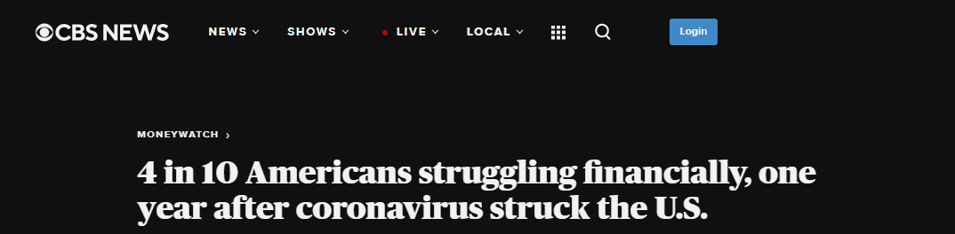
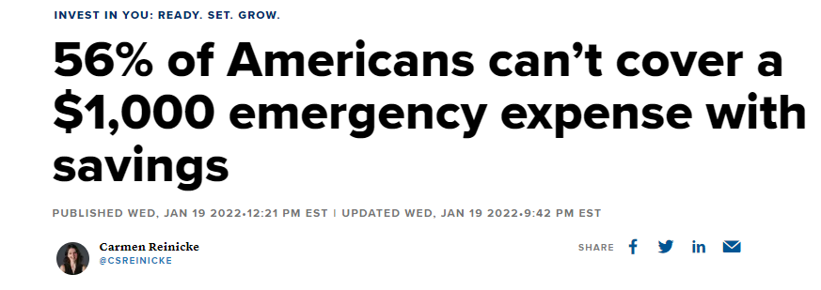
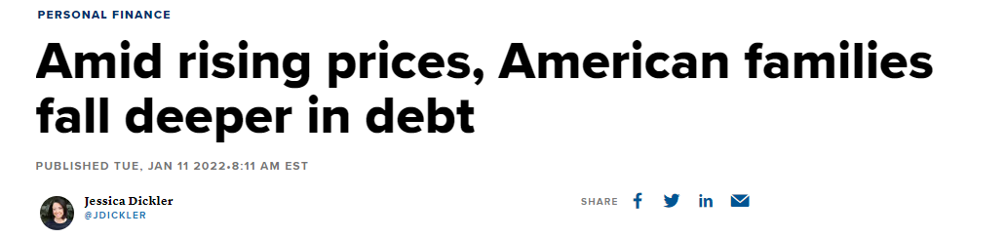
Today’s Headlines in America

Slide 7
Purpose
To draw insights and conclusions from key financial wellbeing metrics captured in the survey conducted in 2016
To gain understanding on what behaviors, habits or factors influence a healthy or poor financial wellbeing

Slide 8
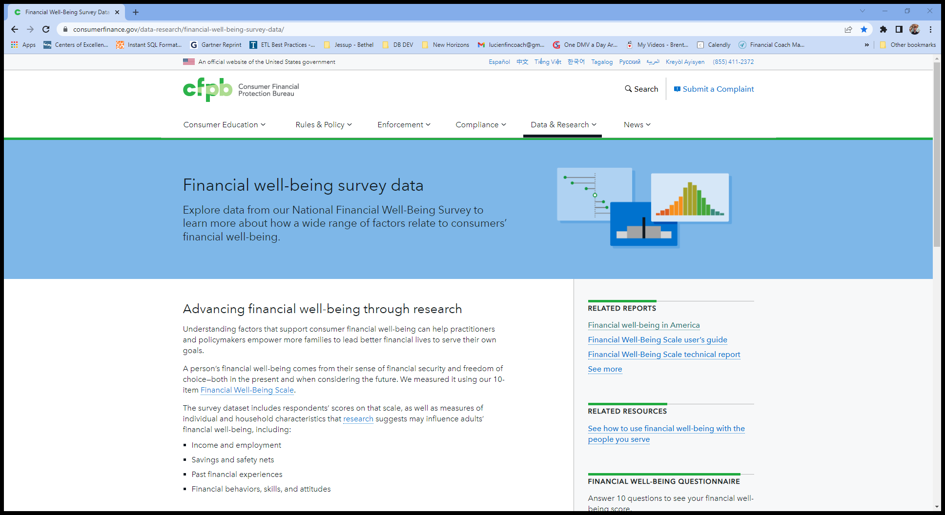
Data
https://www.consumerfinance.gov/data-research/financial-well-being-survey-data/
Consumer Financial Protection Bureau
Advancing financial well-being through research
The National Financial Well-Being Survey was conducted in English and Spanish via web mode between October 27, 2016 and December 5, 2016. Overall, 6,394 surveys were completed: 5,395 from the general population sample and 999 from an oversample of adults aged 62 and older.

Slide 9
What is Financial Well-Being?
Financial well-being is a state of being wherein a person can fully meet current and ongoing financial obligations, can feel secure in their financial future and is able to make choices that allow them to enjoy life.
More specifically, an individual’s financial well-being corresponds to the extent to which the individual feels that he or she:
(1) has control of day-to-day and month-to-month finances;
(2) has the capacity to absorb a financial shock;
(3) is on track to meet financial goals; and
(4) has the freedom to make choices that allow enjoyment of life.

Slide 10
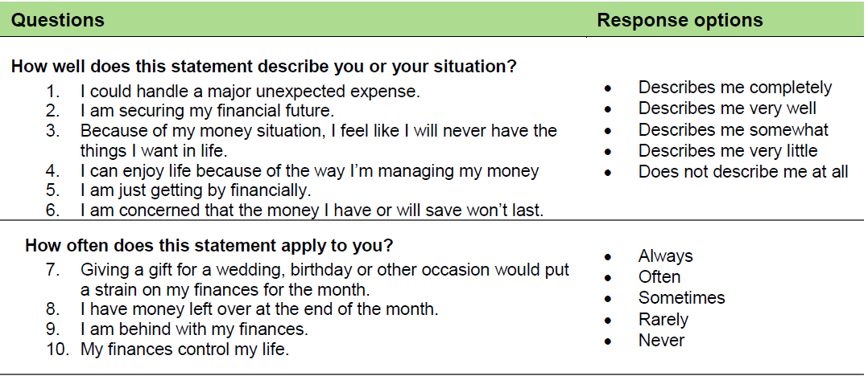
How is Financial Well-Being measured?
The CFPB Financial Well-Being Scale consists of 10 items.19 An individual’s responses to each of the 10 items in the scale are converted into a single score.

Slide 11
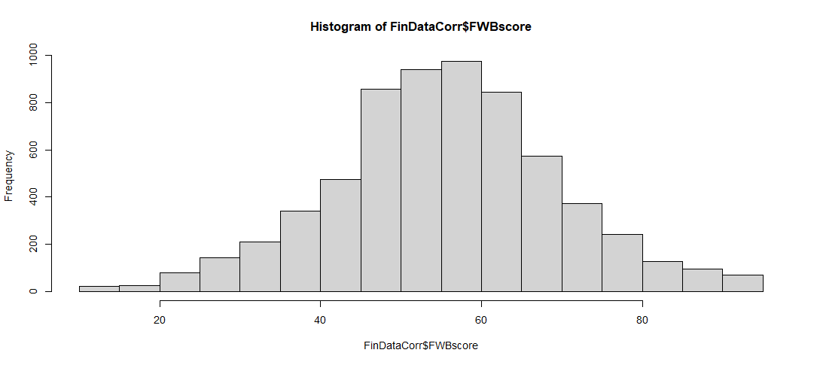
How’s the Financial Well-being scores distributed?
Min: 14
Max: 95
Mean: 56.08
Median: 56
Basic Statistics

Slide 12
Agenda
My Background
Project Introduction
Methods Used
Results
Summary
Conclusions
Questions

Slide 13
Methods Used
Tools
RStudio
Jupyter Notebooks
Analyses
To draw insights and conclusions from key financial wellbeing metrics captured in the survey conducted in 2016
To gain understanding on what behaviors, habits or factors influence a healthy or poor financial wellbeing

Slide 14
Agenda
My Background
Project Introduction
Methods Used
Results
Summary
Conclusions
Questions

Slide 15
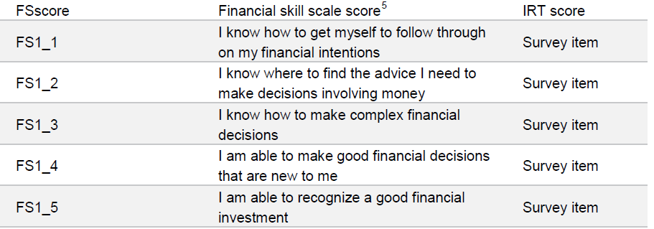
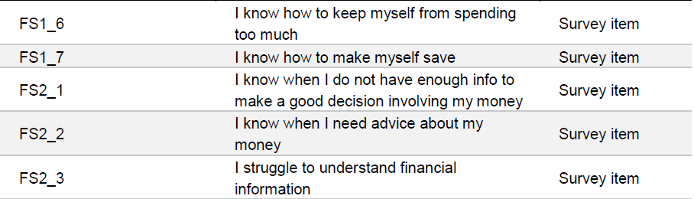
How does the Financial Skill score correlate to the Financial Wellness scale score?

Slide 16
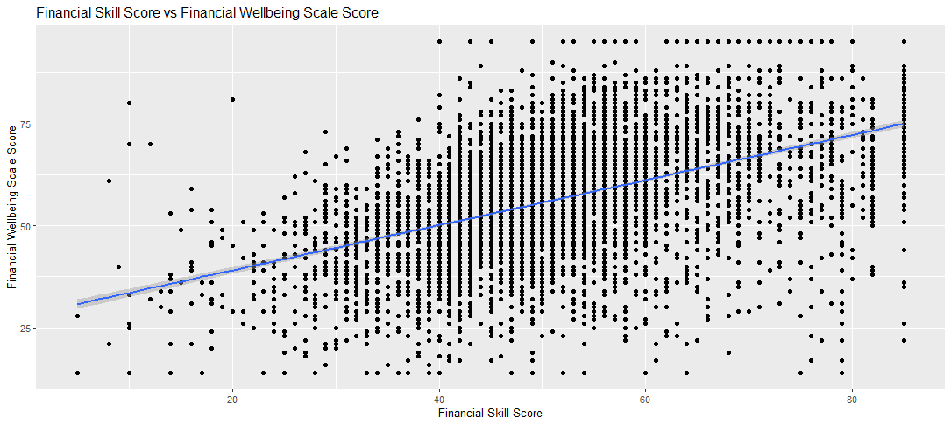
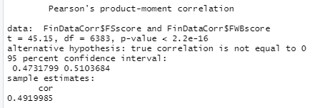
Cont…

Slide 17
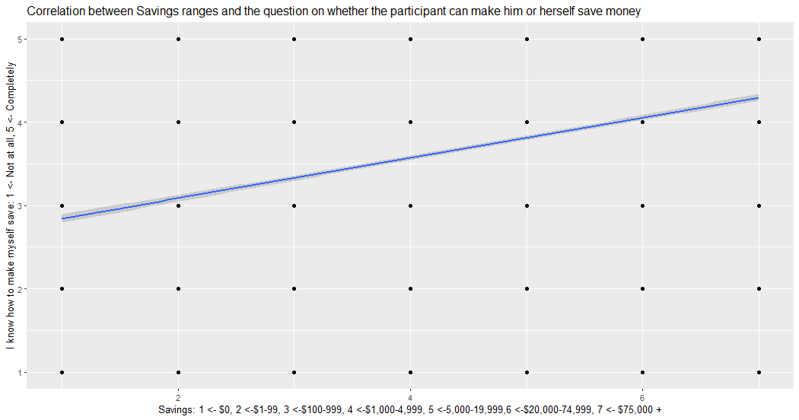
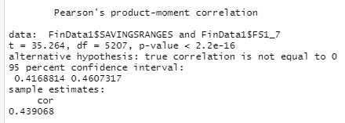
How does FS1_7 "I know how to make myself save" correlate to SAVINGSRANGES “how much money do you have in savings today”?

Slide 18
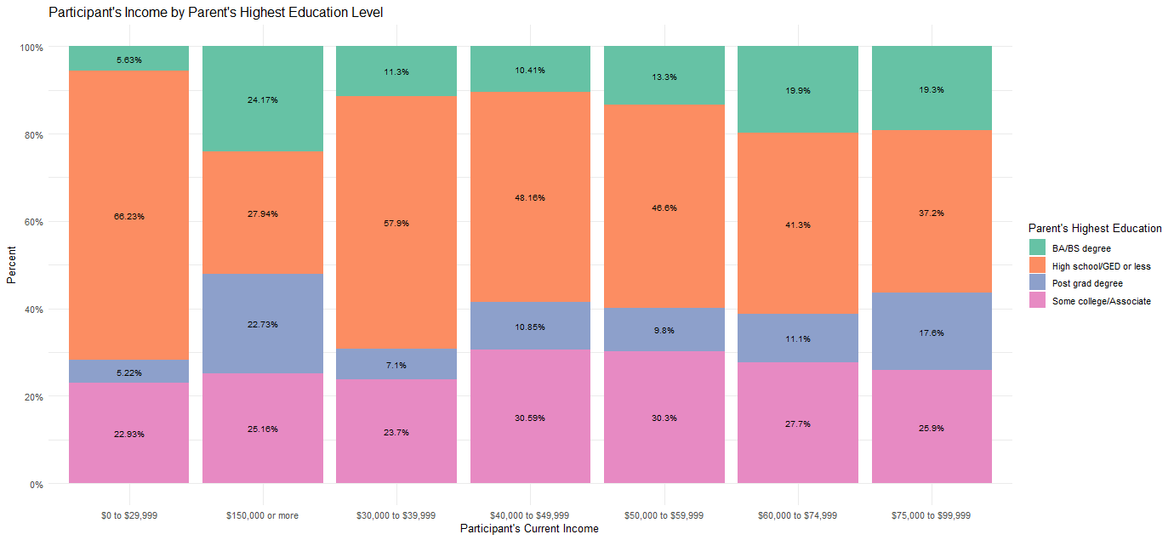
How does PAREDUC Influence current income PPINCIMP?

Slide 19
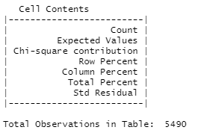
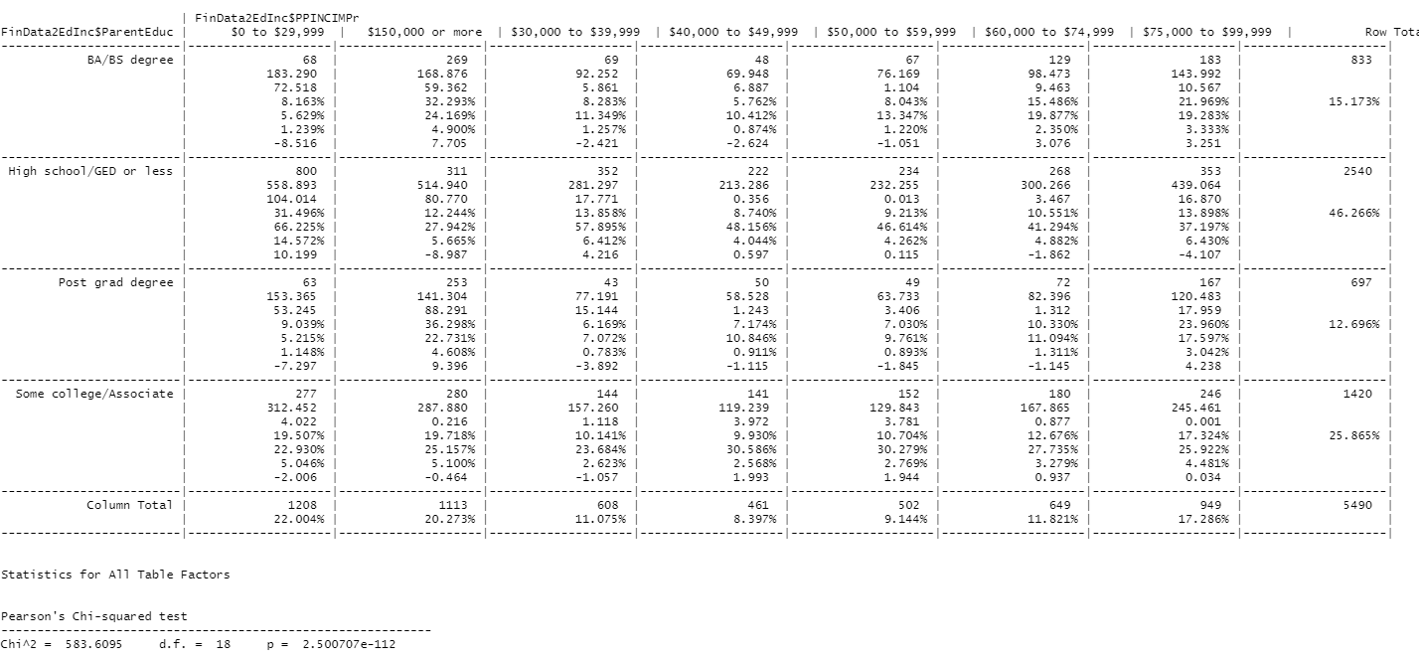
Cont… Independent Chi-Square Analysis – Crosstable

Slide 20
Cont… Independent Chi-Square Analysis – Post Hocs
Based on the p value being less than .05, PAREDUC influences the PPINCIMPr - participant's income.
Post Hocs Interpretation - absolute value of 2 or more is significantly different than the expected value.
For parents with high school or less, more participants earn $30k or less than expected and less participants earn more than $150k than expected.
For parents with some college/associates degree, less participants earn $30K or less than expected but just barely.
For parents with Bachelors degree, less participants earn $30k or less than expected and more earn $150K than expected.
For parents with a post grad degree, less participants earn $30K than expected and more participants earn $150K or more than expected.

Slide 21
Is there a difference in PPINCIMP based on whether the participant sets FINGOALS or not?

Slide 22
Is there a difference in PPINCIMP based on whether the participant sets FINGOALS or not?
More specifically, an individual’s financial well-being corresponds to the extent to which the individual feels that he or she:
(1) has control of day-to-day and month-to-month finances;
(2) has the capacity to absorb a financial shock;
(3) is on track to meet financial goals; and
(4) has the freedom to make choices that allow enjoyment of life.

Slide 23
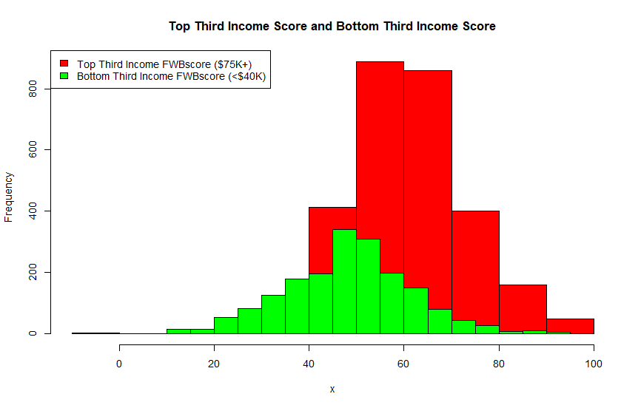
How does the FWBscore compare between the top third and bottom third income brackets?

Slide 24
Agenda
My Background
Project Introduction
Methods Used
Results
Summary
Conclusions
Questions

Slide 25
Summary

Slide 26
Agenda
My Background
Project Introduction
Methods Used
Results
Summary
Conclusions
Questions

Slide 27
Conclusions

Slide 28
Conclusions

Slide 29
Agenda
My Background
Project Introduction
Methods Used
Results
Summary
Conclusions
Questions

Slide 30
Questions?

